Slide 1

Grape Data Analysis – Quality Control
SHUYA ZHANG & ARYAN GUPTA
27/04/20 – WARWICK

Slide 2
Original Sequencing Data
cabsau_R1.fastq cabsau_R2.fastq
chardonnay_R1.fastq chardonnay_R2.fastq
chasselas_R1.fastq chasselas_R2.fastq
gamay_R1.fastq gamay_R2.fastq
muscat.a_R1.fastq muscat.a_R2.fastq
muscat.e_R1.fastq. muscat.e_R2.fastq
pinot.n.aus_R2.fastq pinot.n.aus_R1.fastq
pinot.n_R1.fastq pinot.n_R2.fastq
riparia_R1.fastq riparia_R2.fastq

Slide 3
Step One: Quality Control
Notes:
Fastqc version: FastQC v0.11.4

Slide 4
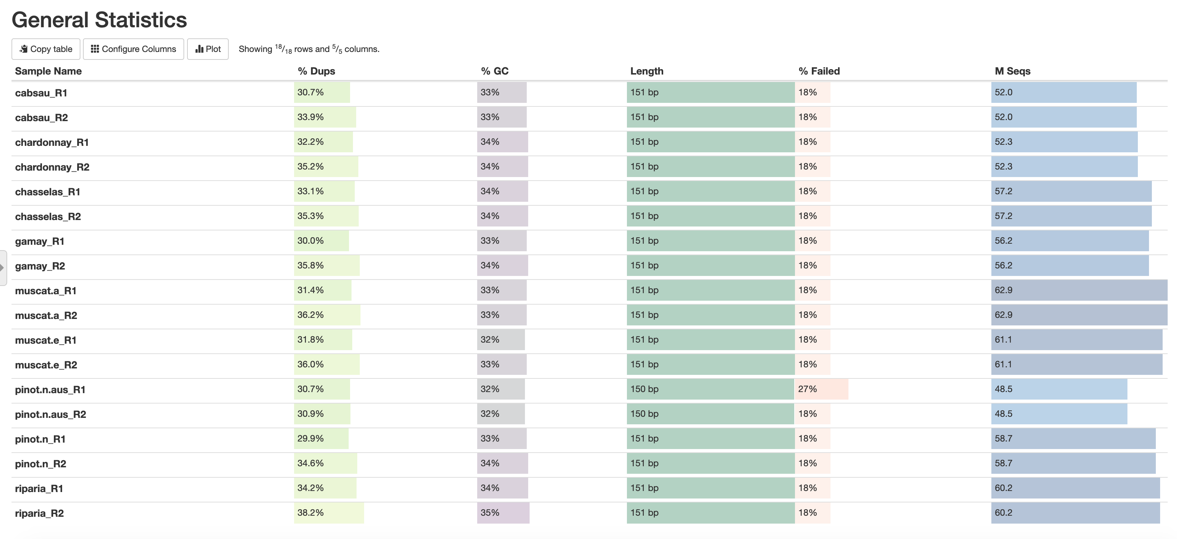

Slide 5
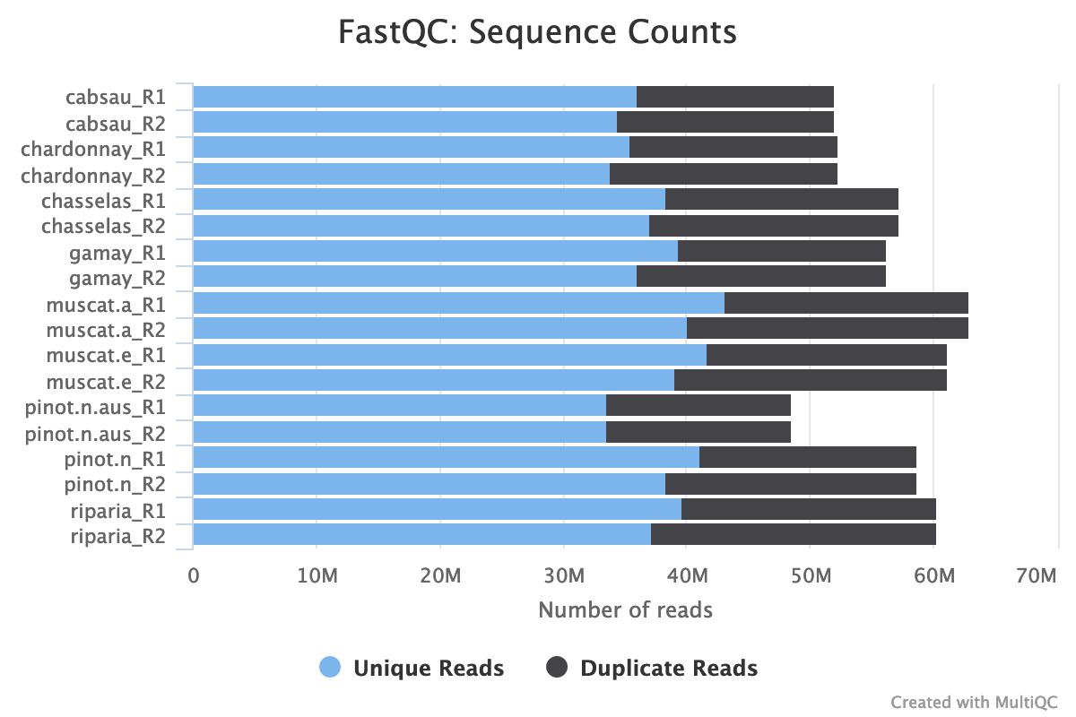
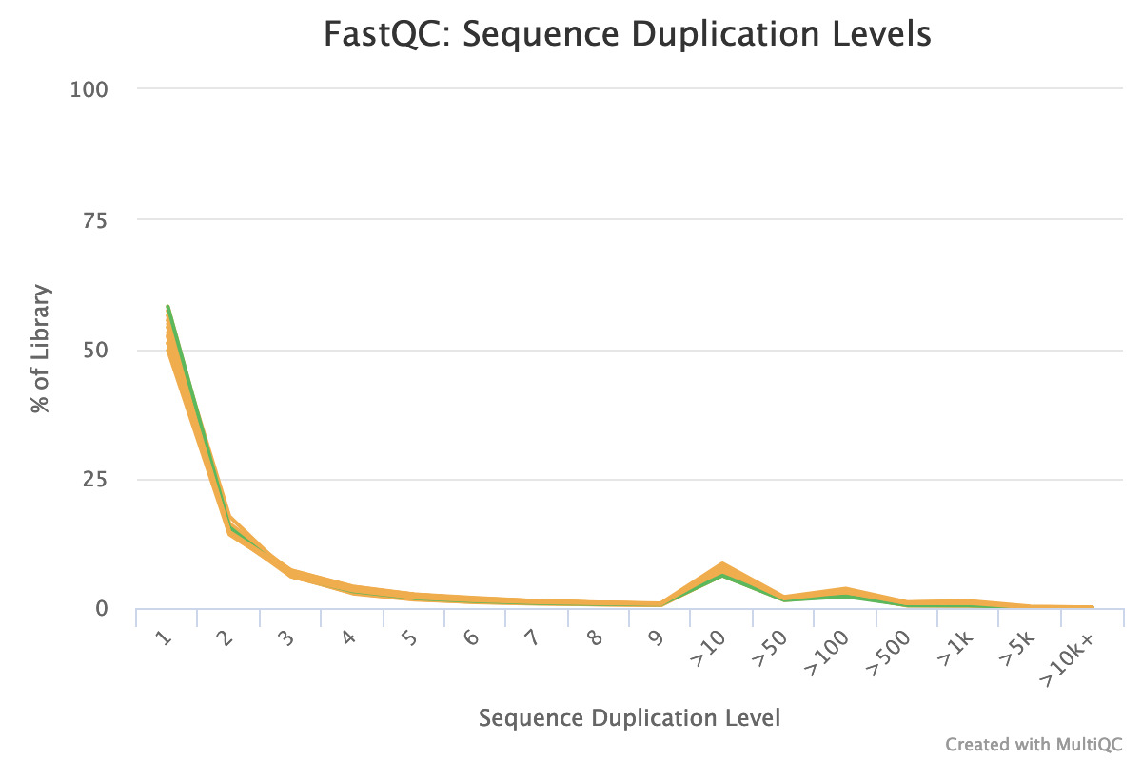
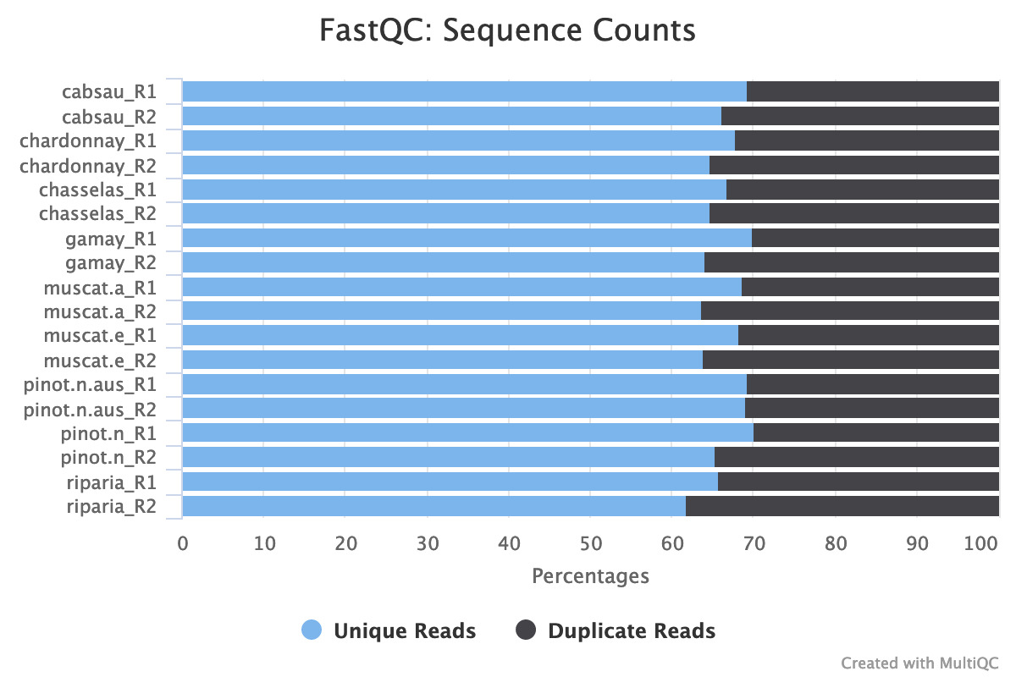

Slide 6
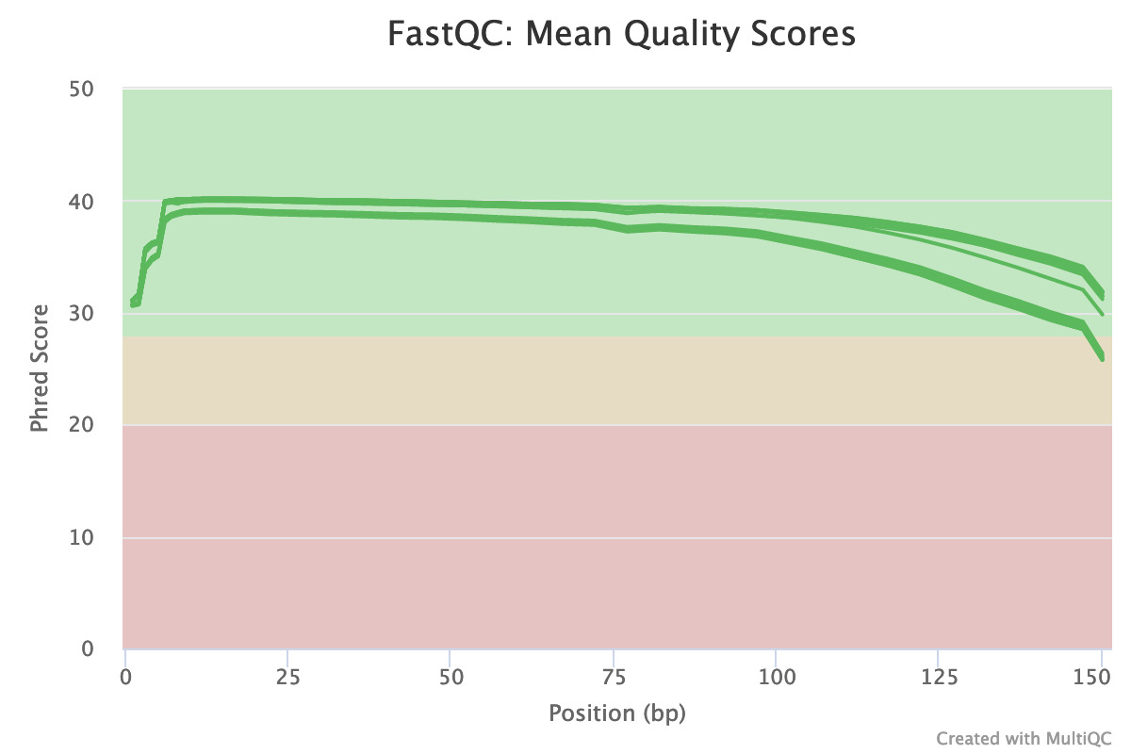
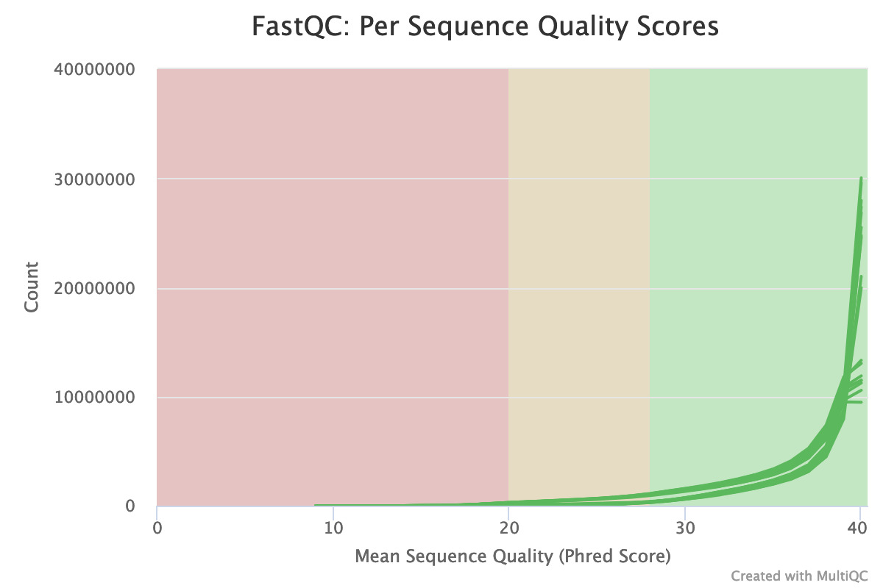
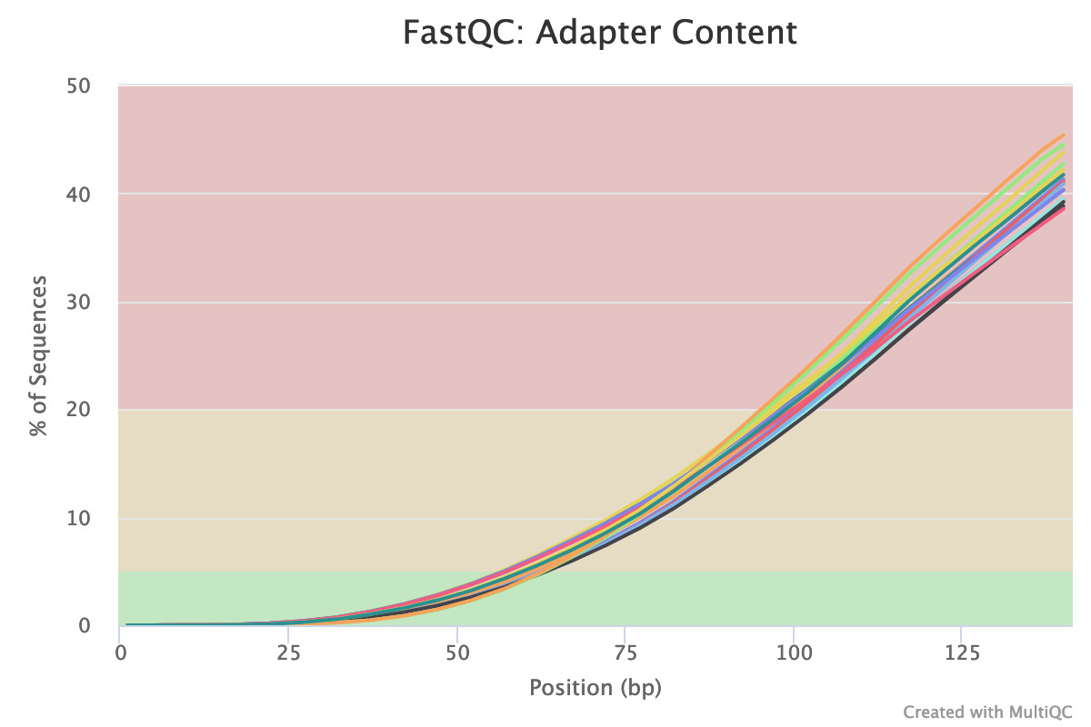
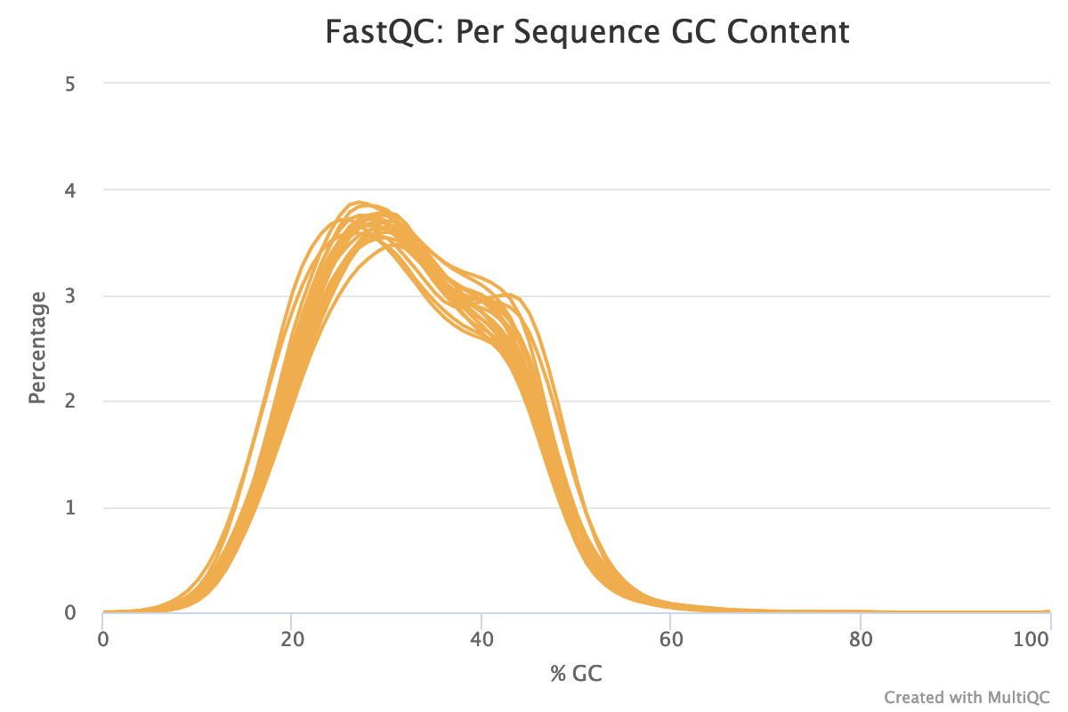
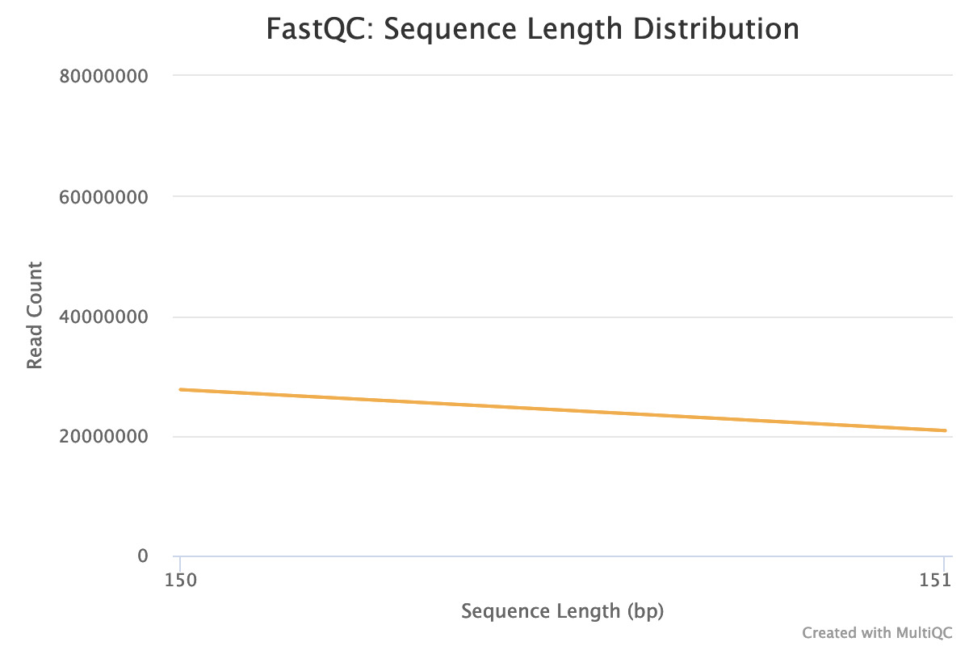
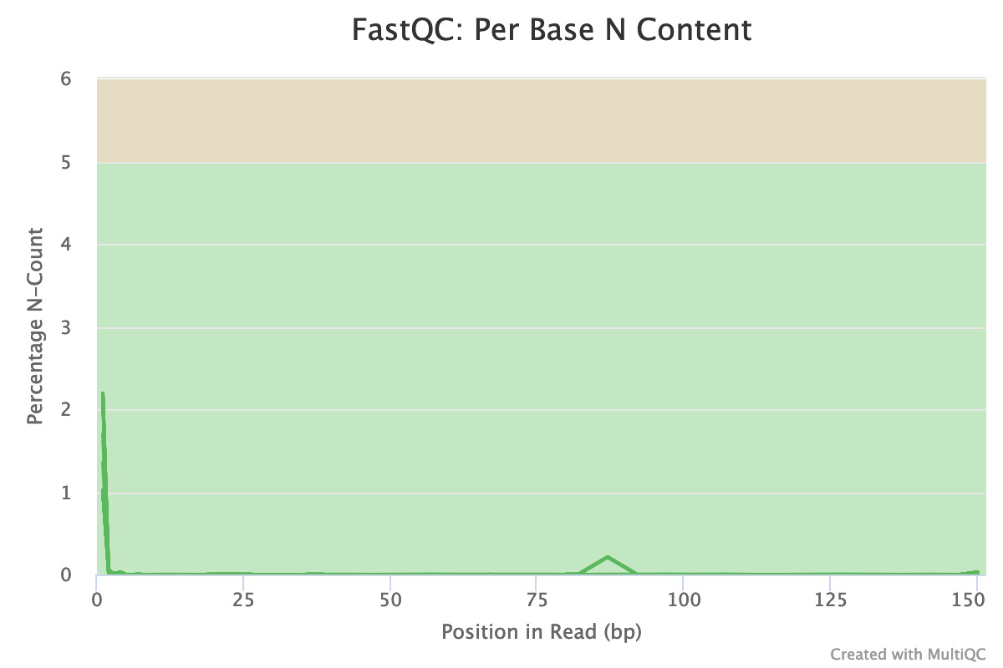

Slide 7
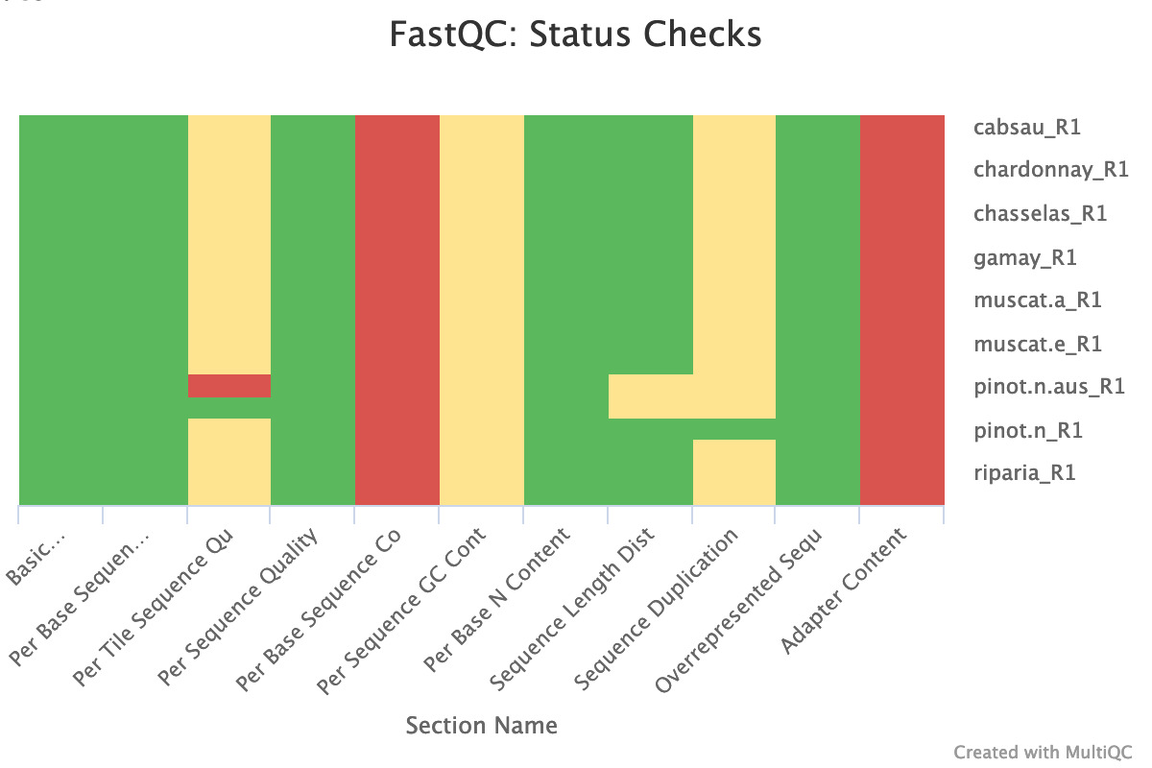
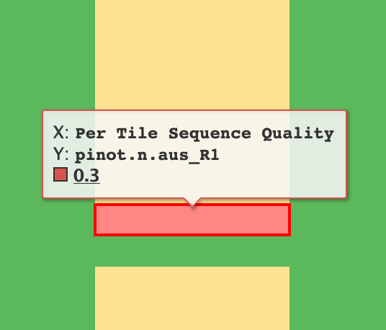
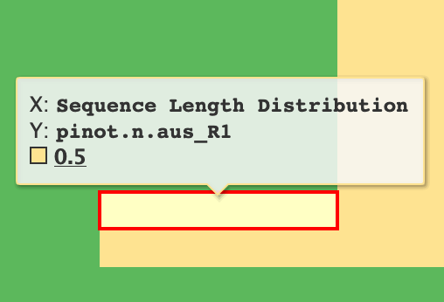

Slide 8
SUMMARY
Overall, WGBS data quality is good (except pinot.n.aus). Quality Phred score are 30-40(above 25) .
Duplication Ratio: from 30% to 40 %
GC content: from 30% to 40 %
Reads length: 151 bp
Adapter content – abnormal → Remove adapters
Per base sequence content → Bisulfite sequencing

Slide 9
Step Two: Cutadapters
Notes:
Trim_galore: → cutadapter
Trim Galore version: 0.4.3
Cutadapt version: 1.9.1
Now performing quality (cutoff 20) and adapter trimming in a single pass for the adapter sequence: 'AGATCGGAAGAGC'

Slide 10
Trimming Report
Input filename: cabsau_R1.fastq
Trimming mode: paired-end
Trim Galore version: 0.4.3
Cutadapt version: 1.9.1
Quality Phred score cutoff: 20
Quality encoding type selected: ASCII+33
Adapter sequence: 'AGATCGGAAGAGC' (Illumina TruSeq, Sanger iPCR; auto-detected)
Maximum trimming error rate: 0.1 (default)
Minimum required adapter overlap (stringency): 1 bp
Minimum required sequence length for both reads before a sequence pair gets removed: 75 bp
This is cutadapt 1.9.1 with Python 2.7.12
Command line parameters: -f fastq -e 0.1 -q 20 -O 1 -a AGATCGGAAGAGC cabsau_R1.fastq
Trimming 1 adapter with at most 10.0% errors in single-end mode ...
Finished in 1319.27 s (25 us/read; 2.36 M reads/minute).

Slide 11
Sample Name | Total reads processed | Reads with adapters | Reads written (passing filters) | Total basepairs processed | Quality-trimmed | Total written (filtered)
cabsau_R1_val_1 | 51,971,262 | 34,324,786 (66.0%) | 51,971,262 (100.0%) | 7,847,660,562 bp | 123,698,871 bp (1.6%) | 6,608,222,077 bp (84.2%)
cabsau_R2_val_2 | 51,971,262 | 35,562,918 (68.4%) | 51,971,262 (100.0%) | 7,847,660,562 bp | 275,872,130 bp (3.5%) | 6,547,923,472 bp (83.4%)
chardonnay_R1_val_1 | 52,306,147 | 35,268,319 (67.4%) | 52,306,147 (100.0%) | 7,898,228,197 bp | 131,531,538 bp (1.7%) | 6,580,312,297 bp (83.3%)
chardonnay_R2_val_2 | 52,306,147 | 36,115,080 (69.0%) | 52,306,147 (100.0%) | 7,898,228,197 bp | 277,003,946 bp (3.5%) | 6,523,844,584 bp (82.6%)
chasselas_R1_val_1 | 57,247,233 | 38,073,678 (66.5%) | 57,247,233 (100.0%) | 8,644,332,183 bp | 133,899,007 bp (1.5%) | 7,270,486,700 bp (84.1%)
chasselas_R2_val_2 | 57,247,233 | 39,124,318 (68.3%) | 57,247,233 (100.0%) | 8,644,332,183 bp | 288,975,856 bp (3.3%) | 7,208,122,588 bp (83.4%)
gamay_R1_val_1 | 56,246,118 | 37,567,072 (66.8%) | 56,246,118 (100.0%) | 8,493,163,818 bp | 166,202,526 bp (2.0%) | 7,042,946,346 bp (82.9%)
gamay_R2_val_2 | 56,246,118 | 38,822,860 (69.0%) | 56,246,118 (100.0%) | 8,493,163,818 bp | 318,201,159 bp (3.7%) | 6,987,763,383 bp (82.3%)
muscat.a_R1_val_1 | 62,938,494 | 41,818,392 (66.4%) | 62,938,494 (100.0%) | 9,503,712,594 bp | 145,788,805 bp (1.5%) | 7,997,650,810 bp (84.2%)
muscat.a_R2_val_2 | 62,938,494 | 43,359,091 (68.9%) | 62,938,494 (100.0%) | 9,503,712,594 bp | 313,975,920 bp (3.3%) | 7,929,137,125 bp (83.4%)
muscat.e_R1_val_1 | 61,121,580 | 40,526,622 (66.3%) | 61,121,580 (100.0%) | 9,229,358,580 bp | 141,412,421 bp (1.5%) | 7,788,250,830 bp (84.4%)
muscat.e_R2_val_2 | 61,121,580 | 42,044,862 (68.8%) | 61,121,580 (100.0%) | 9,229,358,580 bp | 292,607,709 bp (3.2%) | 7,728,066,078 bp (83.7%)
pinot.n.aus_R1_val_1 | 48,518,684 | 33,554,575 (69.2%) | 48,518,684 (100.0%) | 7,298,638,505 bp | 107,004,643 bp (1.5%) | 6,035,160,567 bp (82.7%)
pinot.n.aus_R2_val_2 | 48,518,684 | 35,827,943 (73.8%) | 48,518,684 (100.0%) | 7,298,638,505 bp | 163,917,318 bp (2.2%) | 6,012,873,881 bp (82.4%)
pinot.n_R1_val_1 | 58,728,352 | 38,572,267 (65.7%) | 58,728,352 (100.0%) | 8,867,981,152 bp | 169,265,876 bp (1.9%) | 7,412,149,161 bp (83.6%)
pinot.n_R2_val_2 | 58,728,352 | 39,752,181 (67.7%) | 58,728,352 (100.0%) | 8,867,981,152 bp | 335,537,731 bp (3.8%) | 7,343,150,046 bp (82.8%)
riparia_R1_val_1 | 60,238,673 | 40,866,729 (67.8%) | 60,238,673 (100.0%) | 9,096,039,623 bp | 160,184,154 bp (1.8%) | 7,542,382,321 bp (82.9%)
riparia_R2_val_2 | 60,238,673 | 41,564,839 (69.0%) | 60,238,673 (100.0%) | 9,096,039,623 bp | 331,794,623 bp (3.6%) | 7,474,359,337 bp (82.2%)

Slide 12
SUMMARY
Low quality bases are under 5 %, most of them are 2% -3%.
Another quality control helps to check the trimming effect.

Slide 13
Step Three: Quality Control
Notes:
Trim_galore: → cutadapter
Trim Galore version: 0.4.3
Cutadapt version: 1.9.1

Slide 14
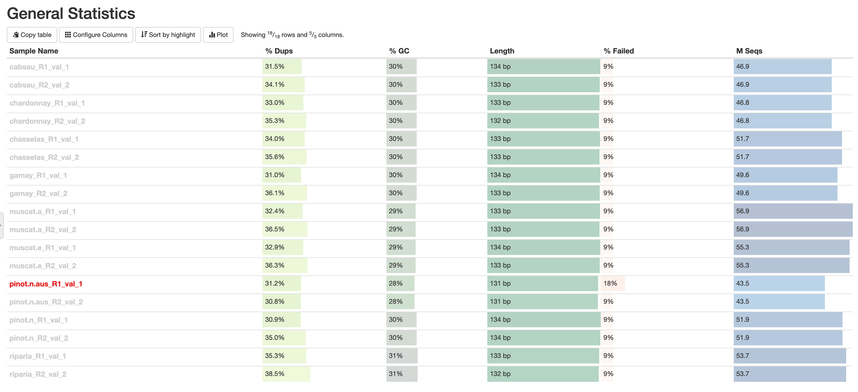

Slide 15
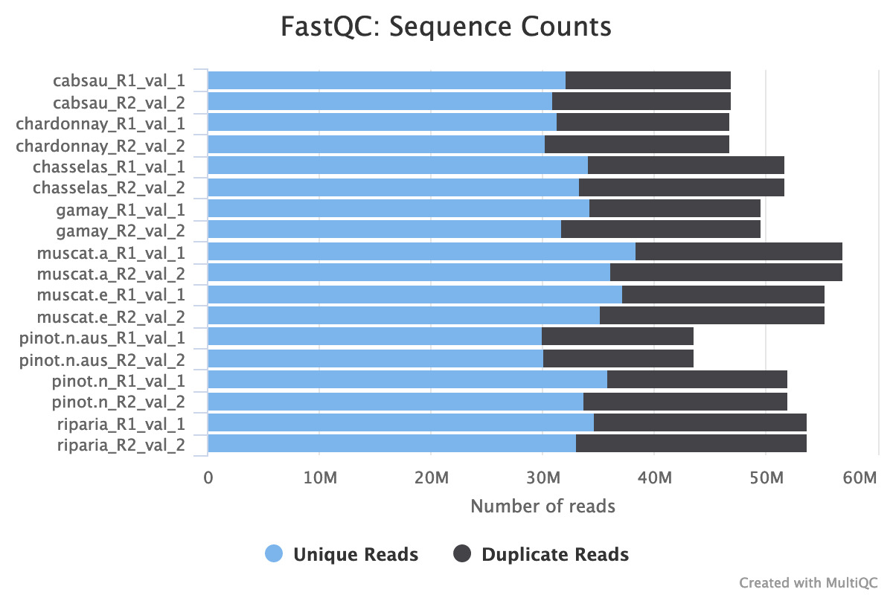
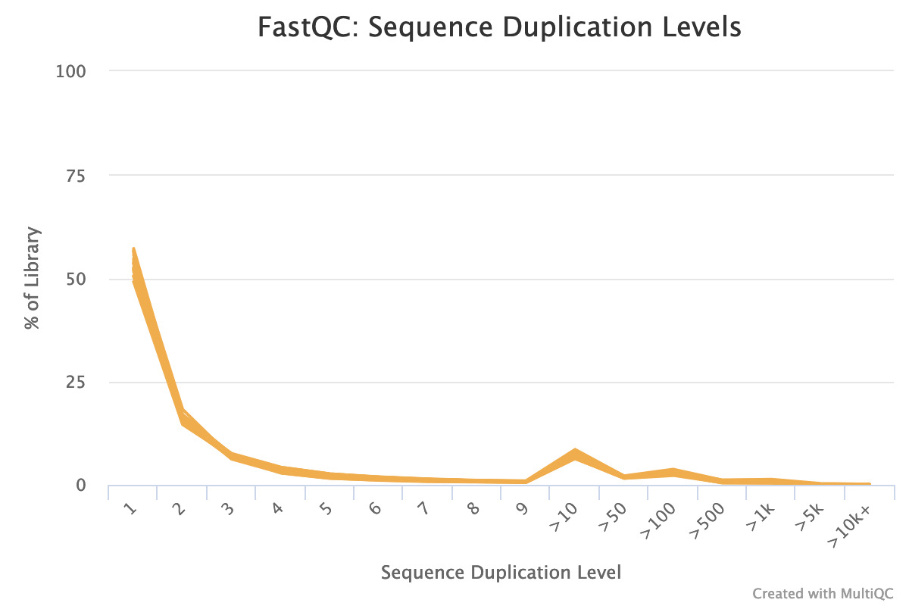
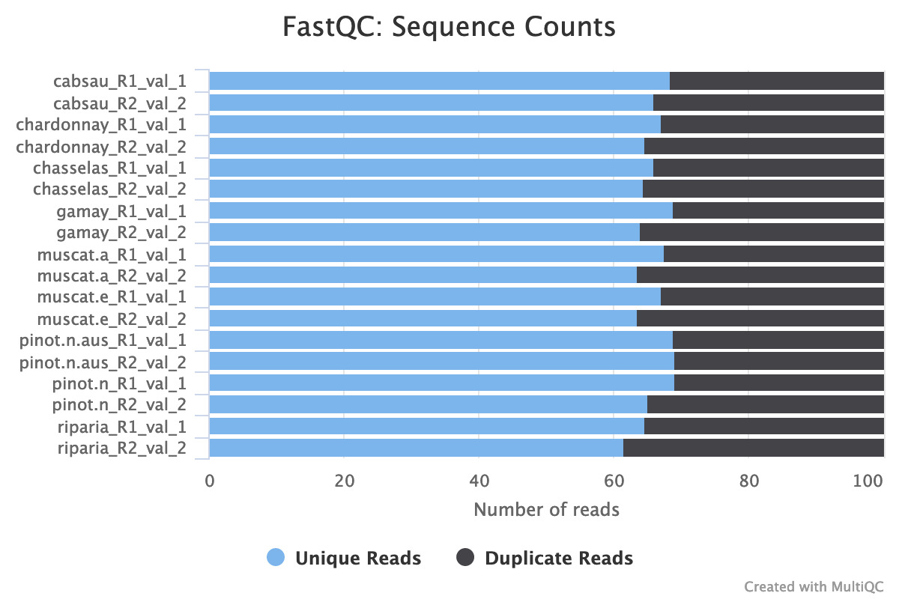

Slide 16
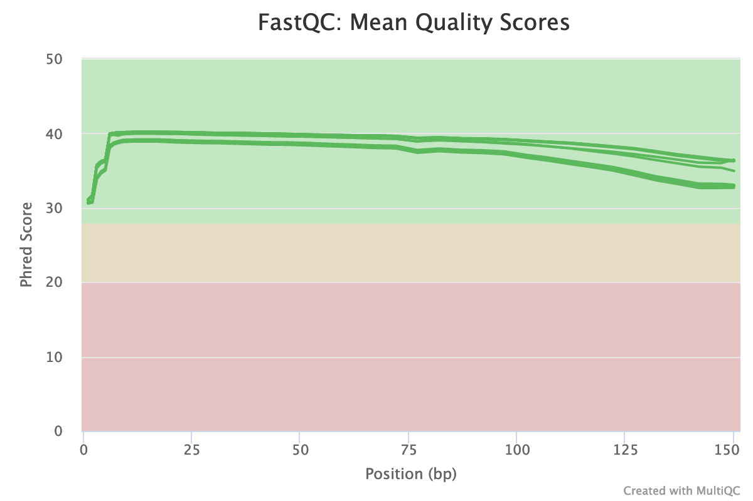
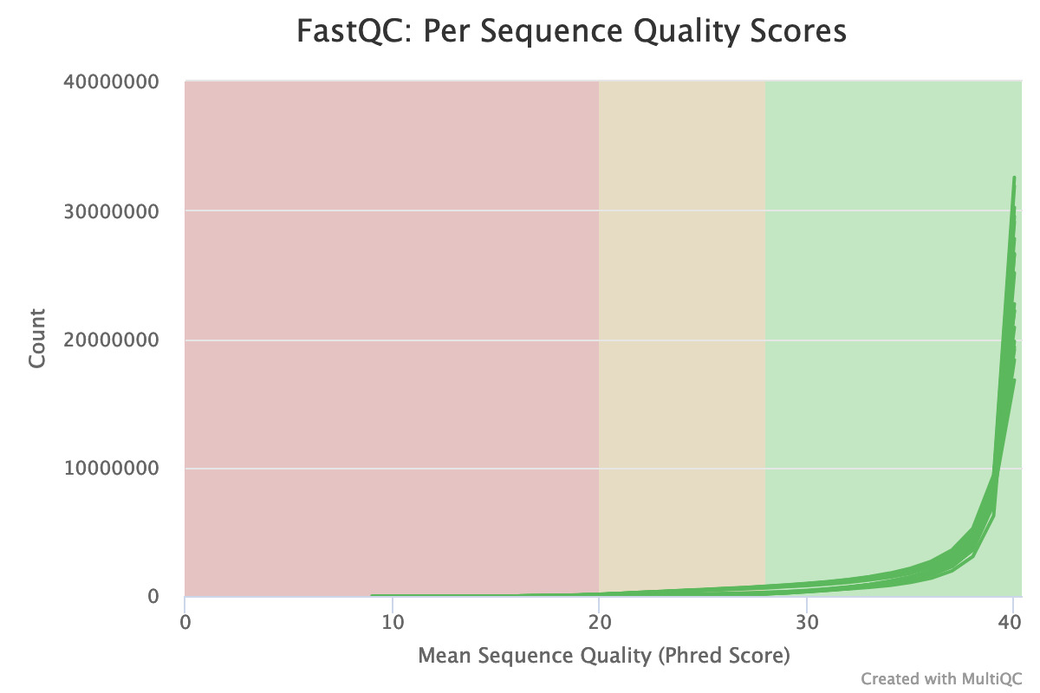
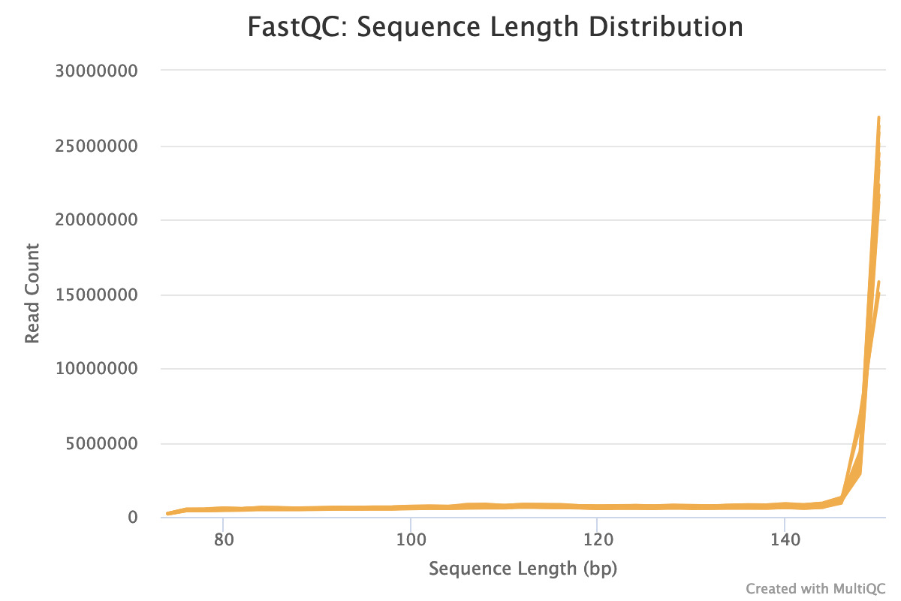

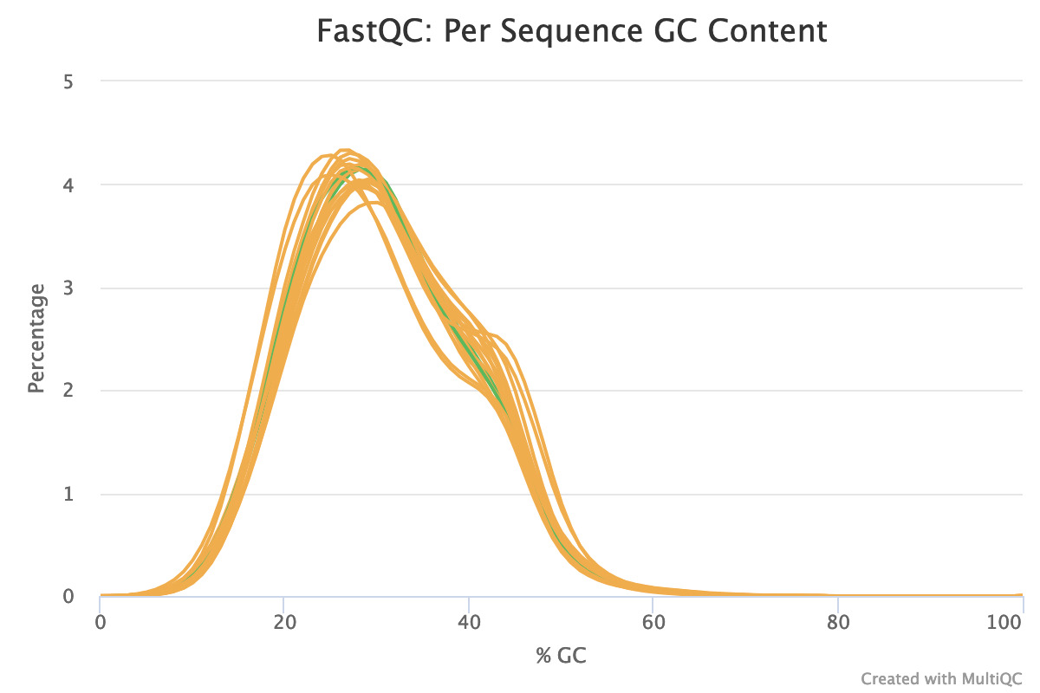

Slide 17
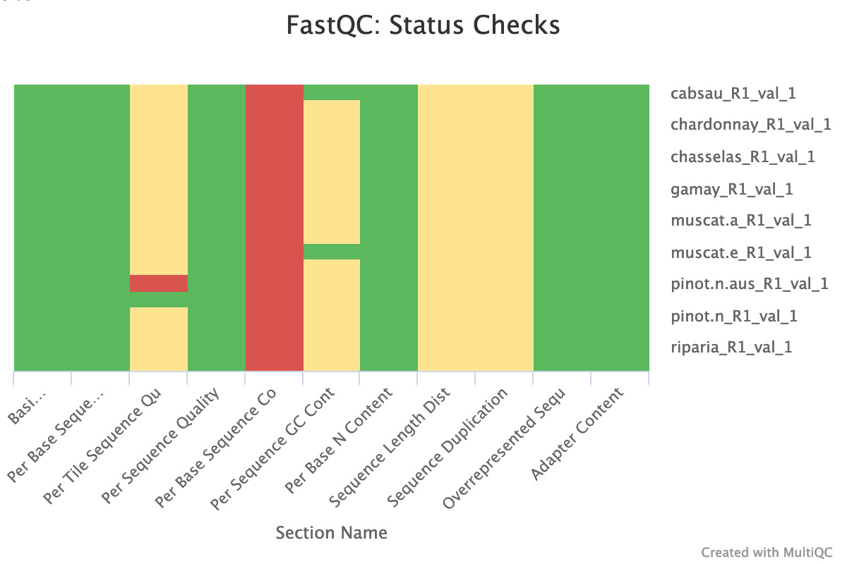
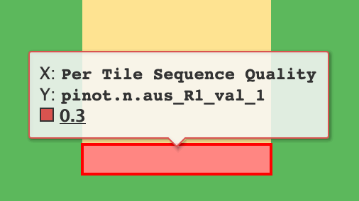

Slide 18
SUMMARY
Overall, all adapters are removed.
Duplication Ratio: from 30% to 40 % (no changes)
GC content: about 30 % (originally 30%-40%)
Reads length: about 134 bp (originally 151 bp)
Per base sequence content → Bisulfite sequencing

Slide 19
Step Four: Alignment

Slide 20
Alignment Report
Bismark report for: cabsau_R1_val_1.fq and cabsau_R2_val_2.fq (version: v0.22.3)
Bismark was run with Bowtie 2 against the bisulfite genome of /mnt/data/shuya/WGBS_modern/ref/ with the specified options: -q --score-min L,0,-0.2 --ignore-quals --no-mixed --no-discordant --dovetail --maxins 500
Option '--directional' specified (default mode): alignments to complementary strands (CTOT, CTOB) were ignored (i.e. not performed)
Final Alignment report
======================
Sequence pairs analysed in total: 46875652
Number of paired-end alignments with a unique best hit: 21919982
Mapping efficiency: 46.8%
Sequence pairs with no alignments under any condition: 16805300
Sequence pairs did not map uniquely: 8150370
Sequence pairs which were discarded because genomic sequence could not be extracted: 102
Number of sequence pairs with unique best (first) alignment came from the bowtie output:
CT/GA/CT: 10880440 ((converted) top strand)
GA/CT/CT: 0 (complementary to (converted) top strand)
GA/CT/GA: 0 (complementary to (converted) bottom strand)
CT/GA/GA: 11039440 ((converted) bottom strand)
Number of alignments to (merely theoretical) complementary strands being rejected in total: 0
Total number of C's analysed: 1059536956
Total methylated C's in CpG context: 88912397
Total methylated C's in CHG context: 90567352
Total methylated C's in CHH context: 35216744
Total methylated C's in Unknown context: 57600
Total unmethylated C's in CpG context: 38675814
Total unmethylated C's in CHG context: 85002043
Total unmethylated C's in CHH context: 721162606
Total unmethylated C's in Unknown context: 375714
C methylated in CpG context: 69.7%
C methylated in CHG context: 51.6%
C methylated in CHH context: 4.7%
C methylated in unknown context (CN or CHN): 13.3%

Slide 21
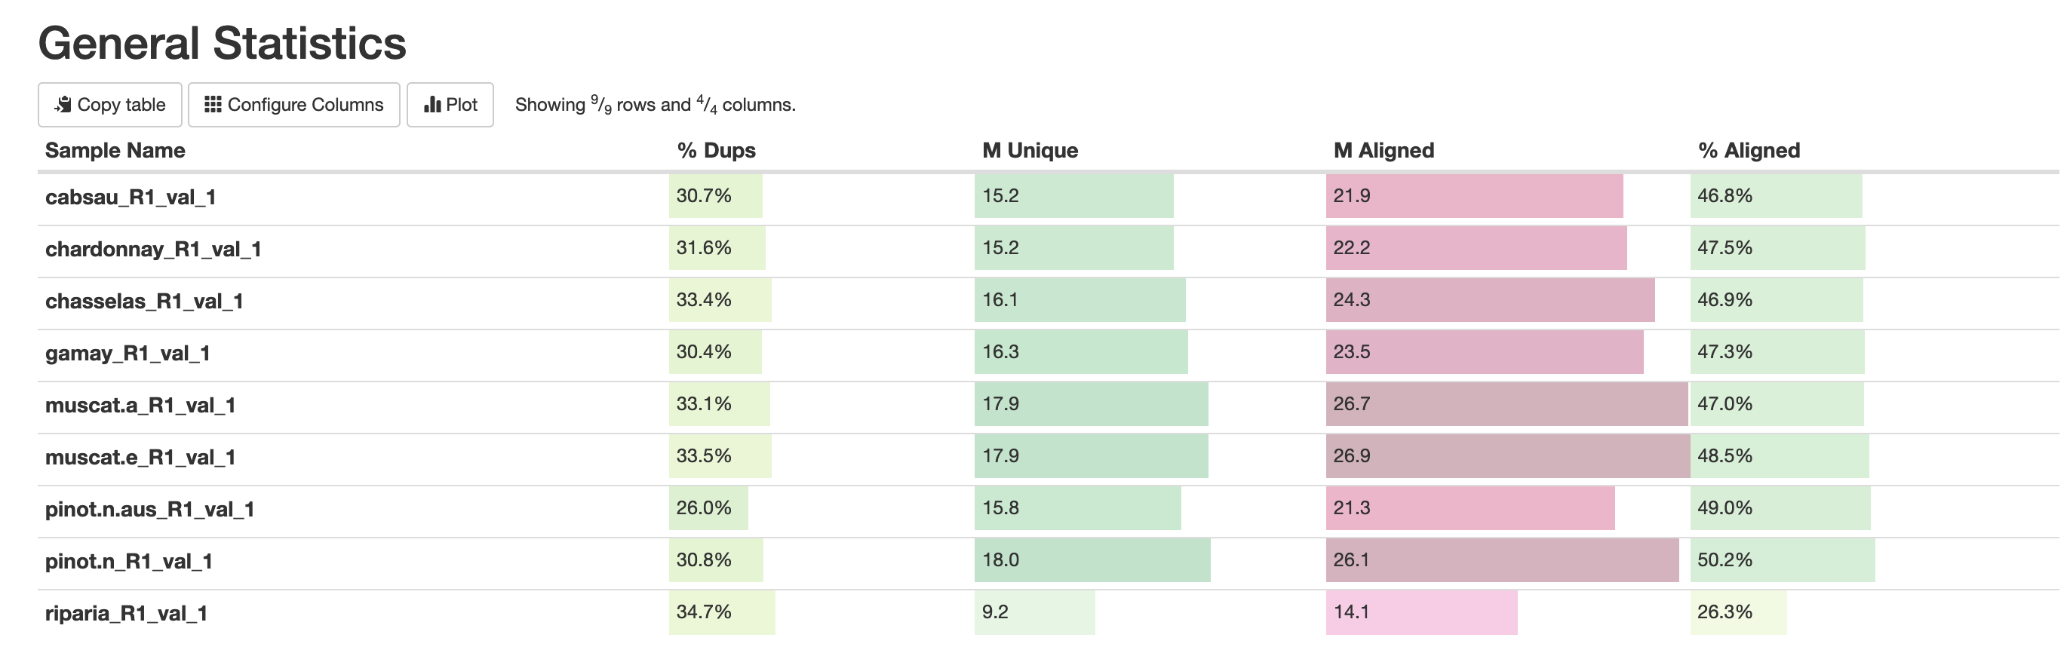
9 bismark alignment reports

Slide 22
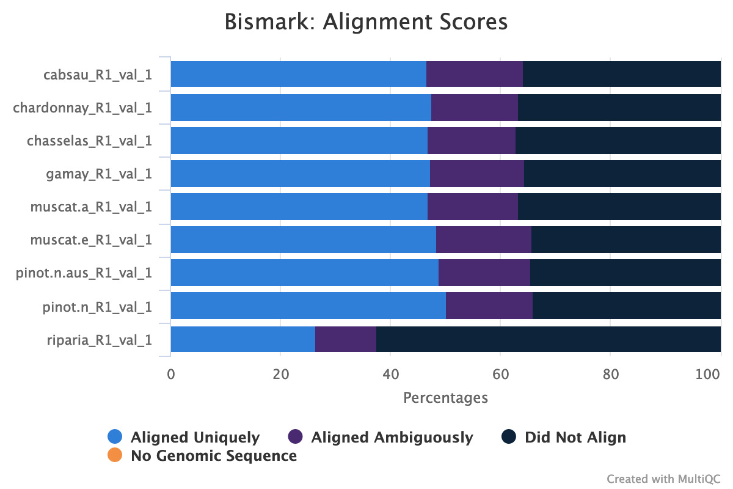
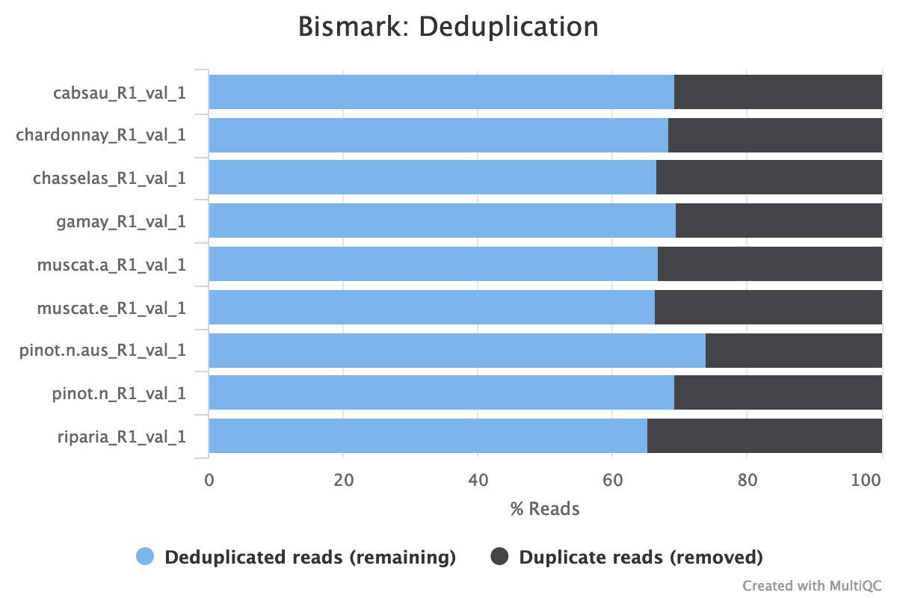
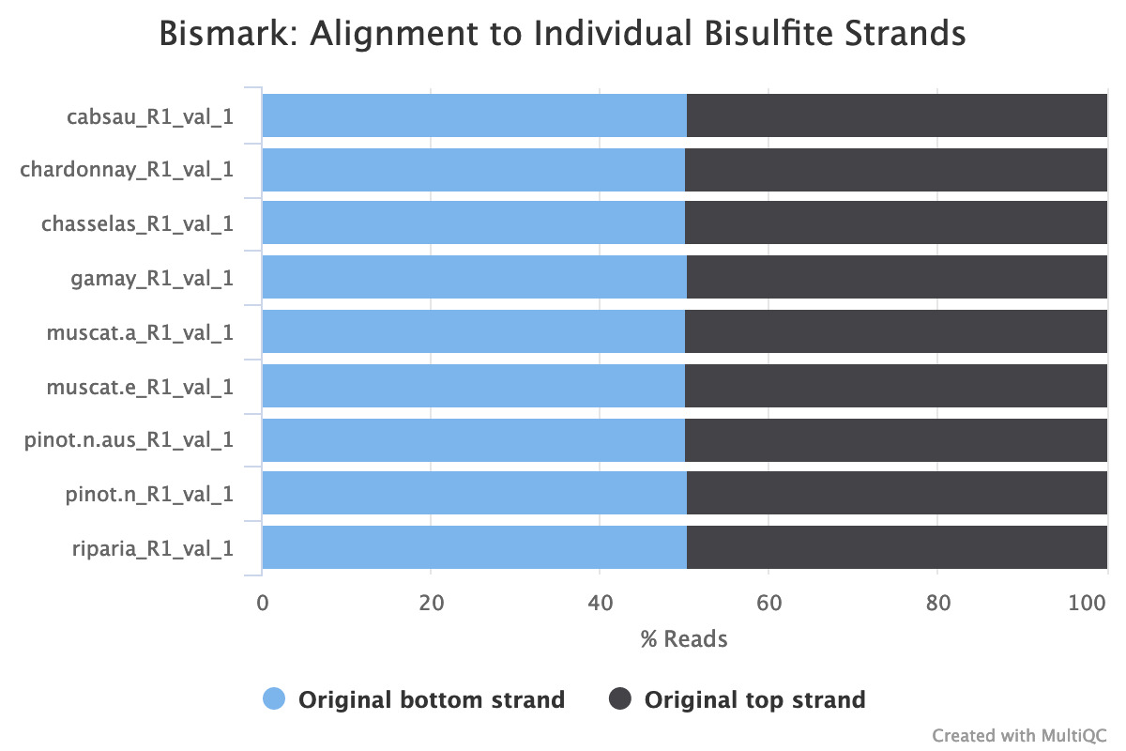
9 bismark alignment reports
Notes:
Should check …

Slide 23
SUMMARY
The mapping efficiency is reasonable, however, it might be improved.
Unique reads mapping efficiency : about 50 %
Total reads mapping efficiency : 60 % to 70%
Actual mapping efficiency : over 50%, probably near 60%
Per base sequence content → Bisulfite sequencing
Notes:
Yeast mapping efficiency :75 %
Grape genome is larger, so ….
Maize genome = 4 X Grape genome

Slide 24
How to improve mapping efficiency
Contamination
Reads length (√)
Using a more relaxed scoring function (--score_min L,0,-0.6) Originally –score-min L,0,-0.2
Shifting bowtie 1 or bowtie2 version
Library construction: directional library or non-directional library (√)
Narrowing the source of errors down by systematically trimming the reads either from the 5' side (e.g. trim 10, 20, 30bp) or the 3' side

Slide 25
Step Five: Deduplication

Slide 26
Alignment Report
Bismark report for: cabsau_R1_val_1.fq and cabsau_R2_val_2.fq (version: v0.22.3)
Bismark was run with Bowtie 2 against the bisulfite genome of /mnt/data/shuya/WGBS_modern/ref/ with the specified options: -q --score-min L,0,-0.2 --ignore-quals --no-mixed --no-discordant --dovetail --maxins 500
Option '--directional' specified (default mode): alignments to complementary strands (CTOT, CTOB) were ignored (i.e. not performed)
Final Alignment report
======================
Sequence pairs analysed in total: 46875652
Number of paired-end alignments with a unique best hit: 21919982
Mapping efficiency: 46.8%
Sequence pairs with no alignments under any condition: 16805300
Sequence pairs did not map uniquely: 8150370
Sequence pairs which were discarded because genomic sequence could not be extracted: 102
Number of sequence pairs with unique best (first) alignment came from the bowtie output:
CT/GA/CT: 10880440 ((converted) top strand)
GA/CT/CT: 0 (complementary to (converted) top strand)
GA/CT/GA: 0 (complementary to (converted) bottom strand)
CT/GA/GA: 11039440 ((converted) bottom strand)
Number of alignments to (merely theoretical) complementary strands being rejected in total: 0
Total number of C's analysed: 1059536956
Total methylated C's in CpG context: 88912397
Total methylated C's in CHG context: 90567352
Total methylated C's in CHH context: 35216744
Total methylated C's in Unknown context: 57600
Total unmethylated C's in CpG context: 38675814
Total unmethylated C's in CHG context: 85002043
Total unmethylated C's in CHH context: 721162606
Total unmethylated C's in Unknown context: 375714
C methylated in CpG context: 69.7%
C methylated in CHG context: 51.6%
C methylated in CHH context: 4.7%
C methylated in unknown context (CN or CHN): 13.3%

Slide 27
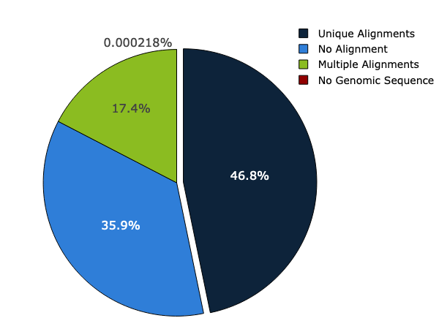
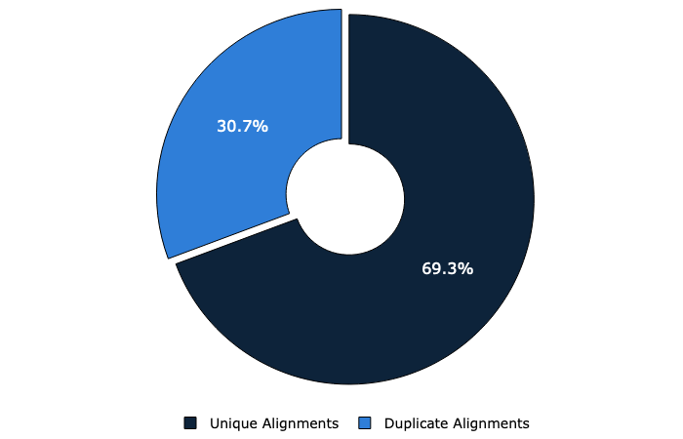
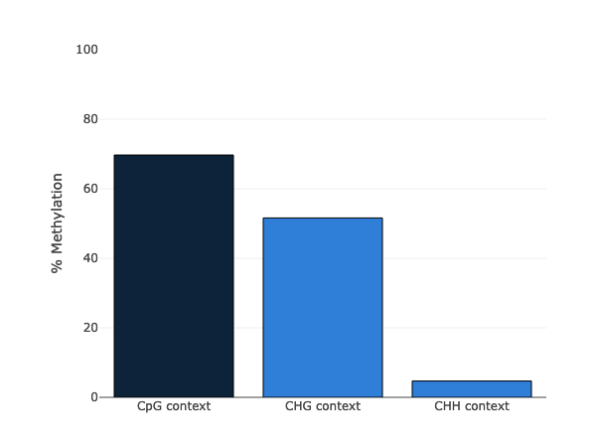
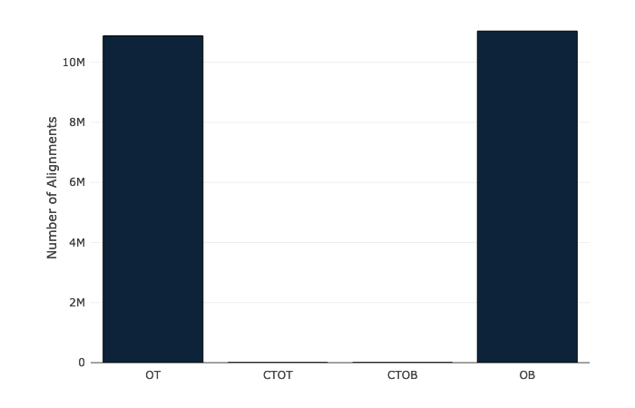
Notes:
Might be useful if we use these plots to describe individual species

Slide 28
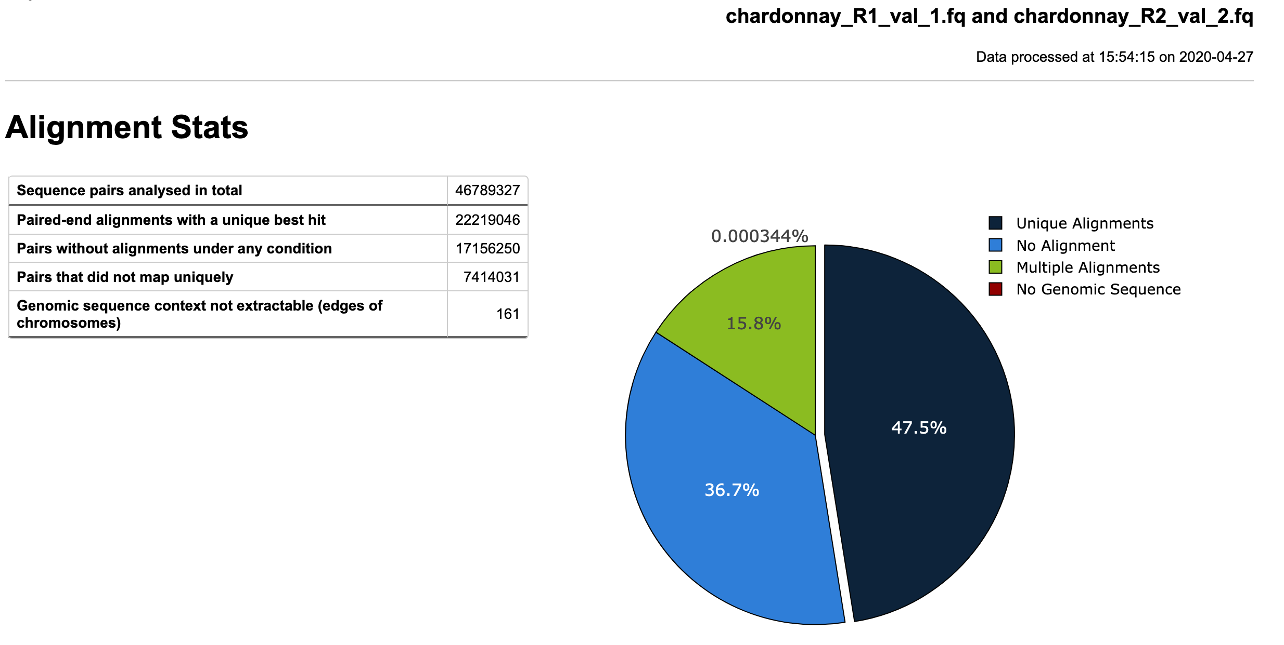

Slide 29
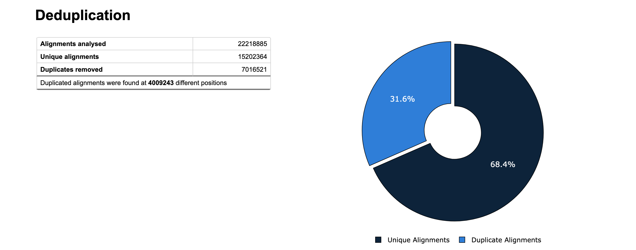

Slide 30
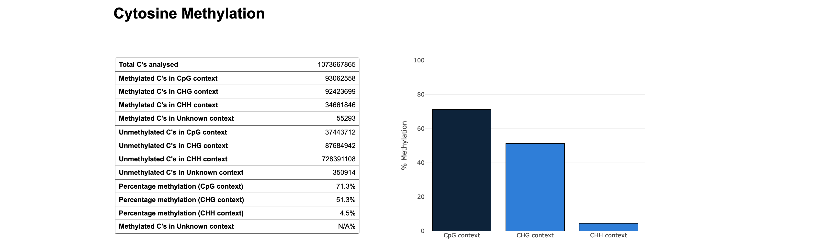
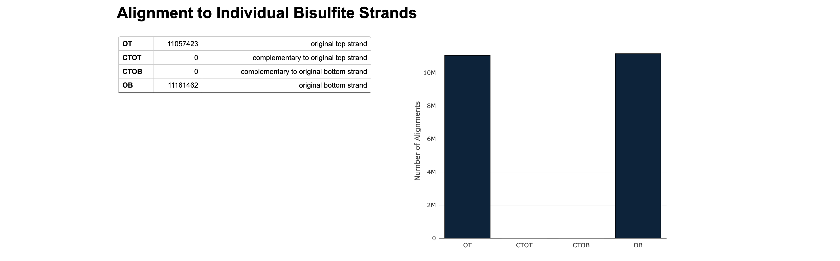

Slide 31
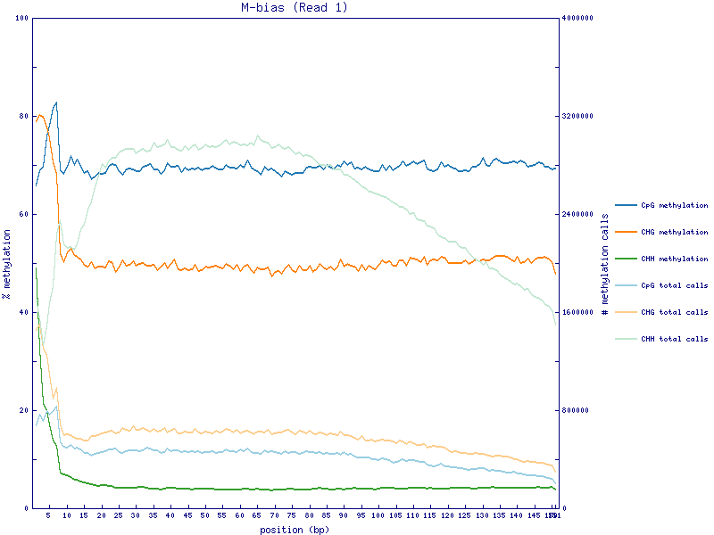
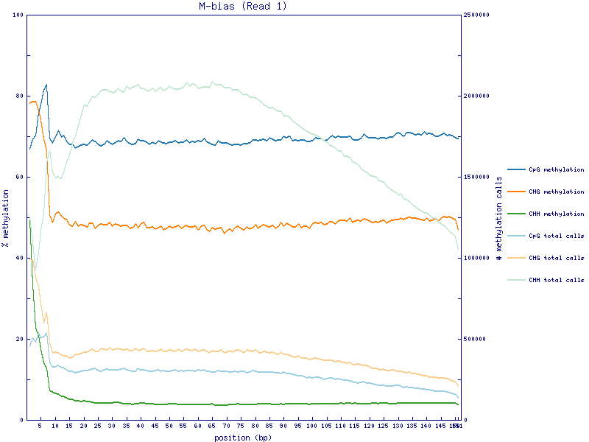
Before Deduplication
After Deduplication

Slide 32
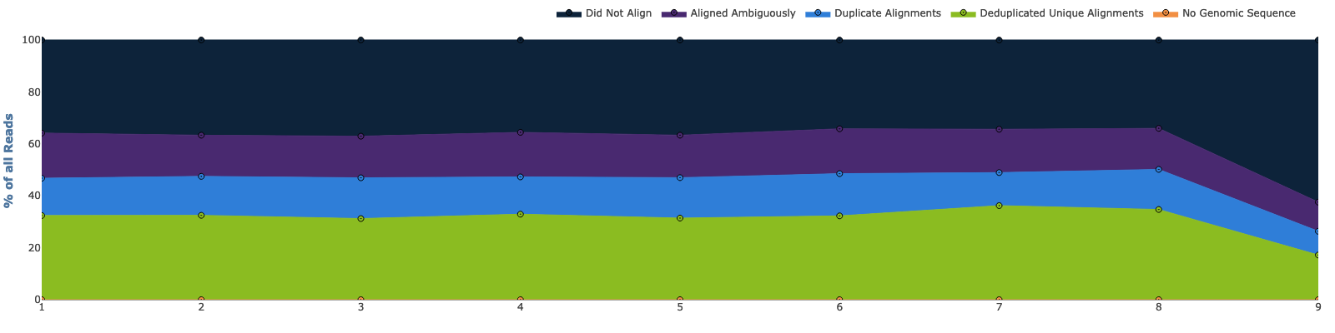
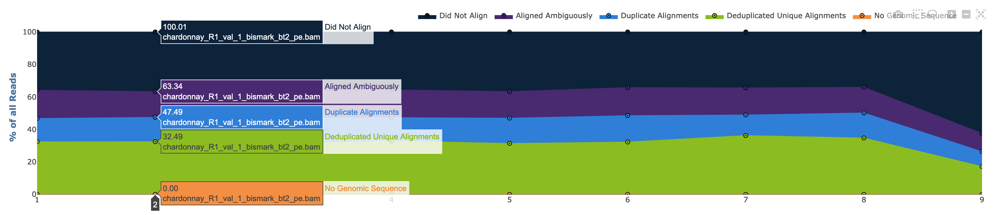
Bismark Alignment Stats Numbers

Slide 33
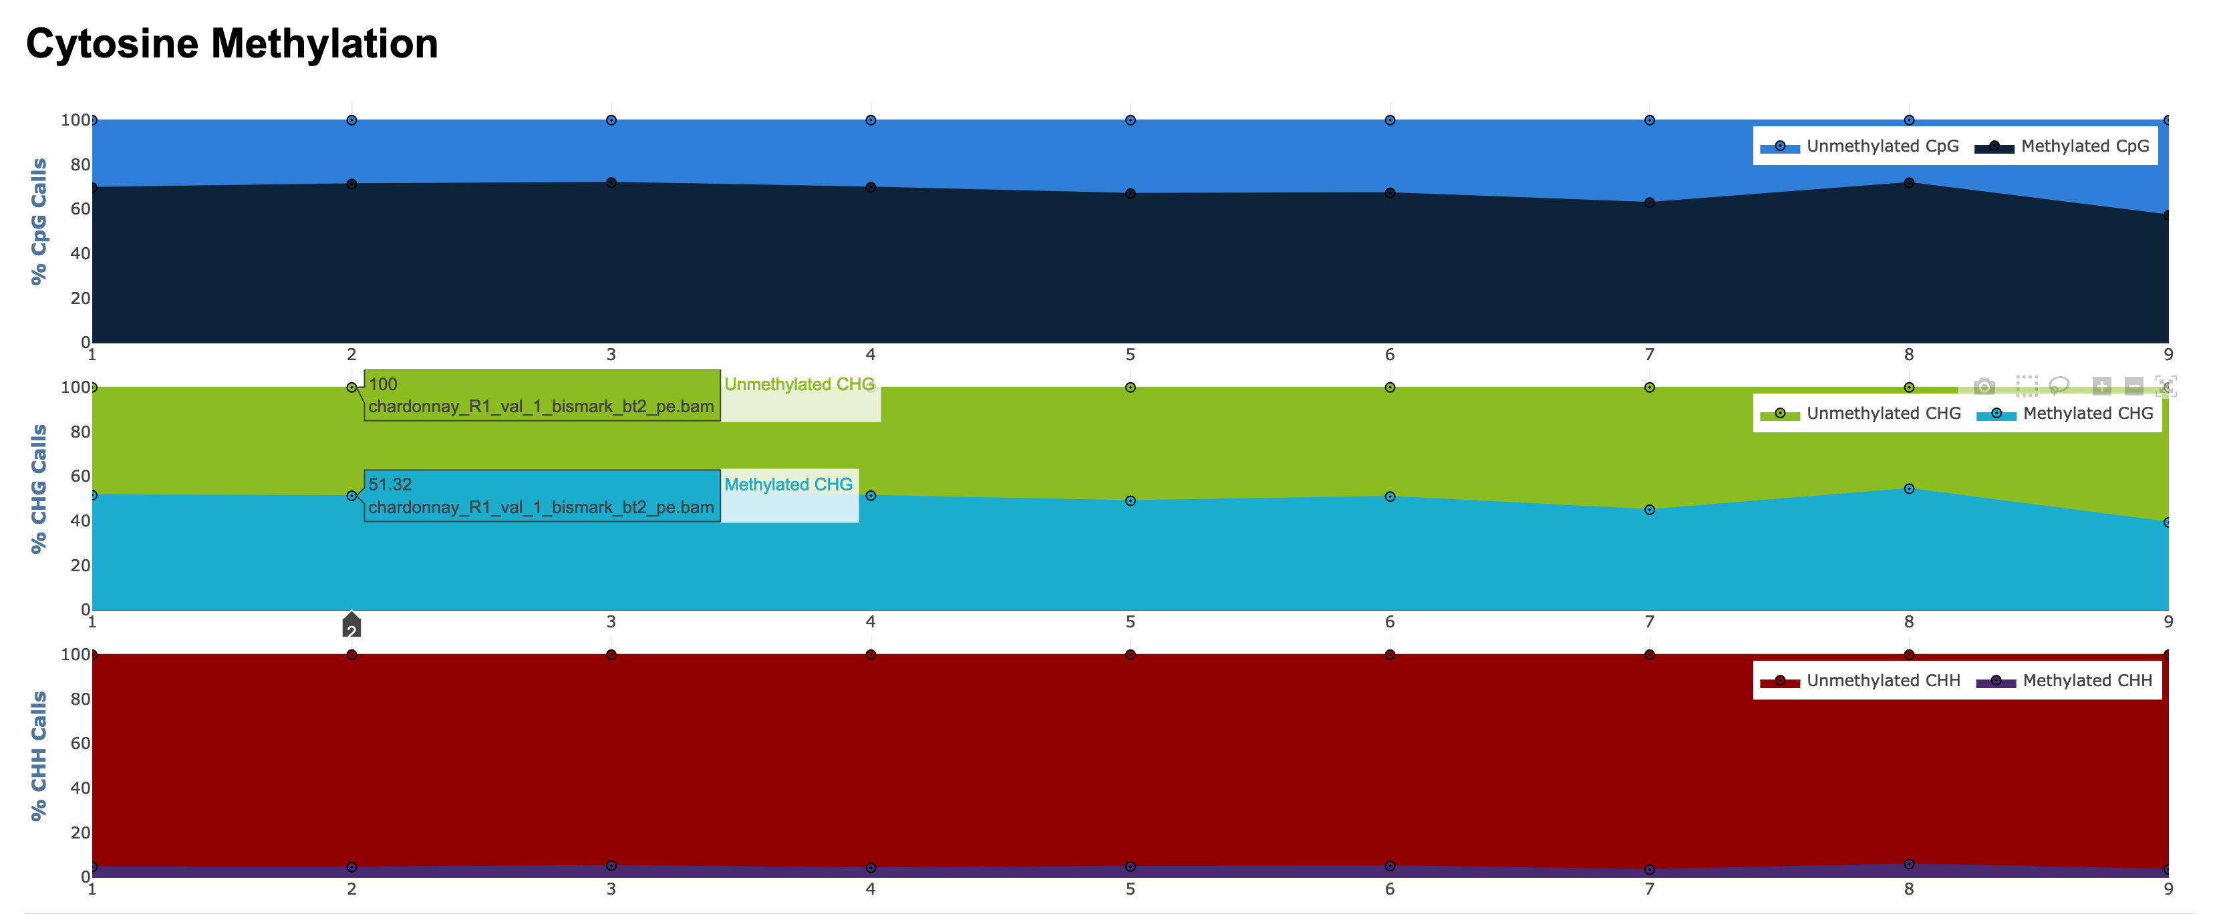
Cytosine Methylation are in CpG, CHG context

Slide 34
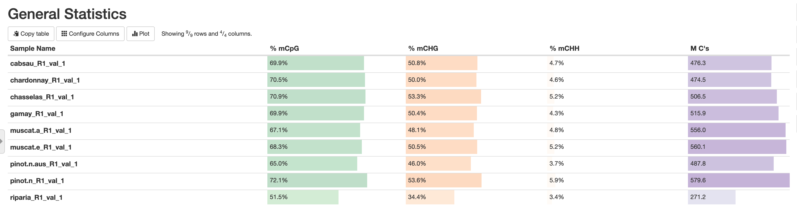
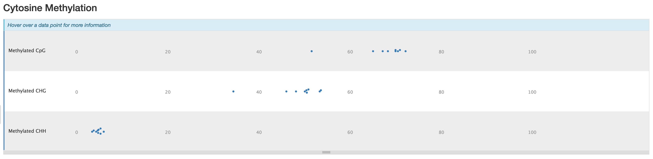
Cytosine Methylation are in CpG, CHG context
Methylation ratios in CpG are 70 %, and 50% in CHG, while 5% in CHH.

Slide 35
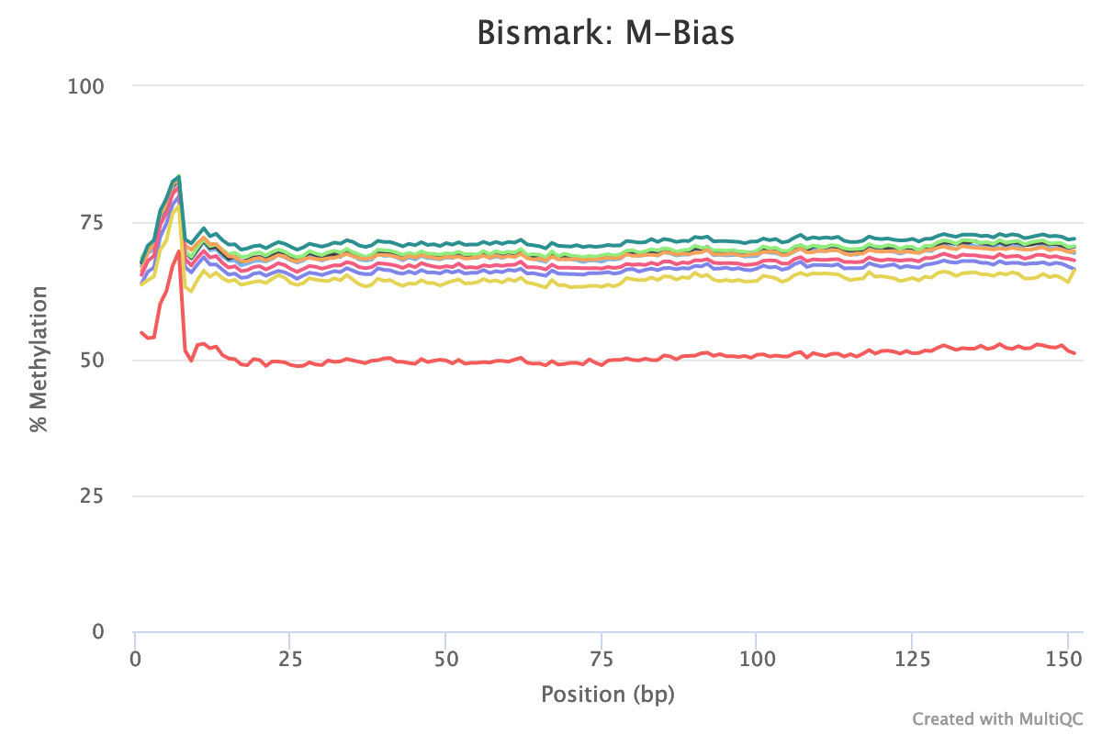
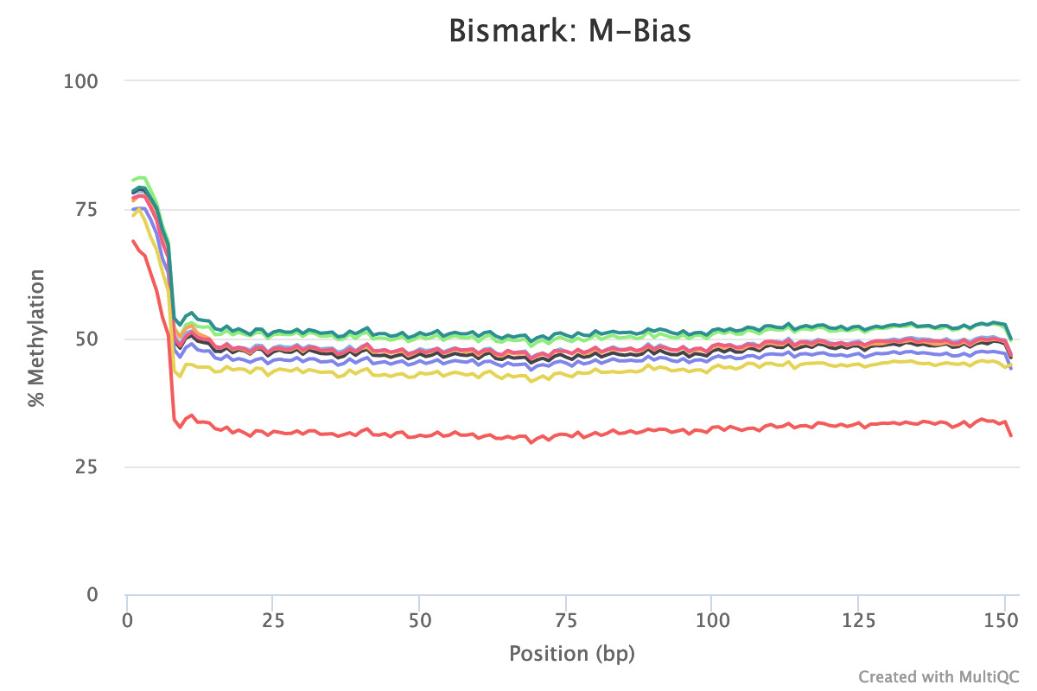
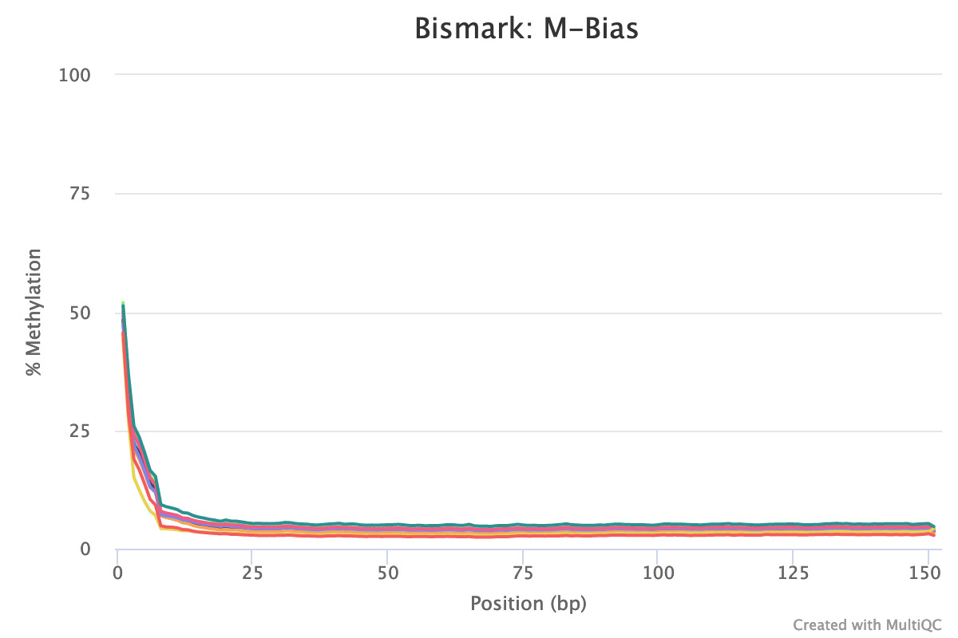
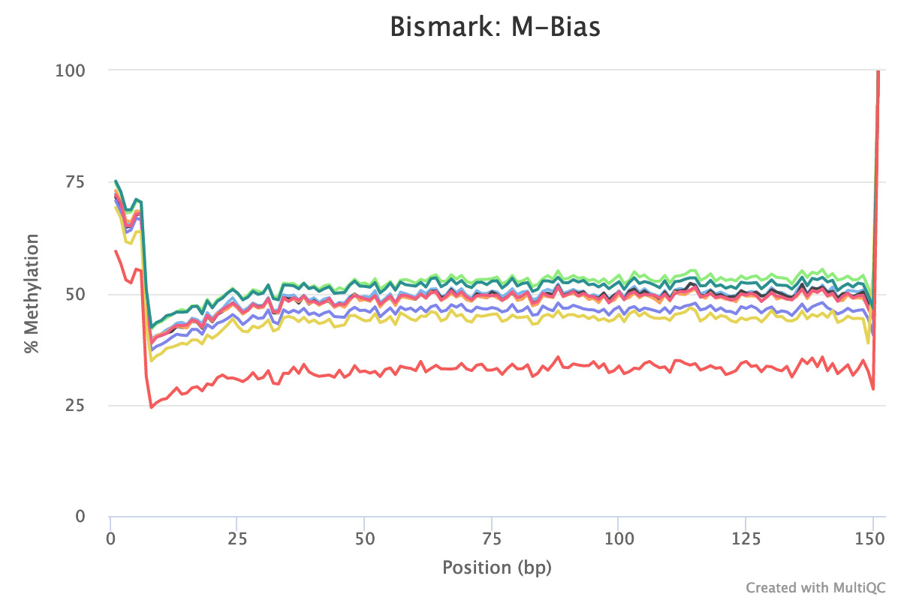
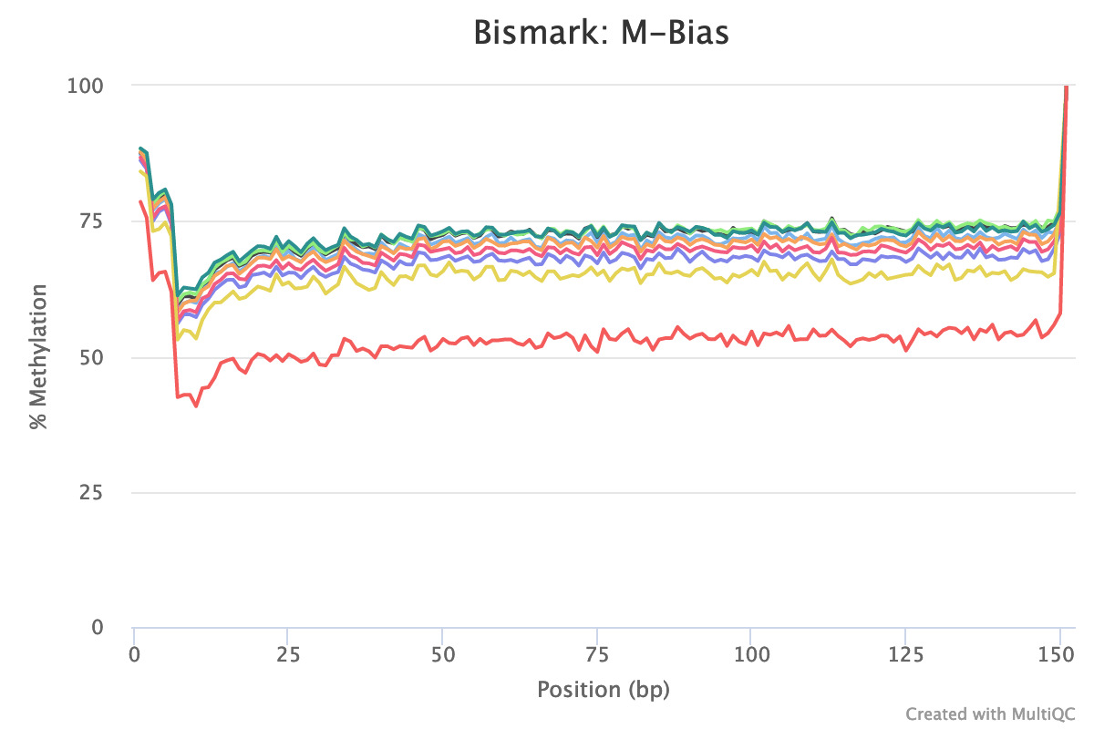
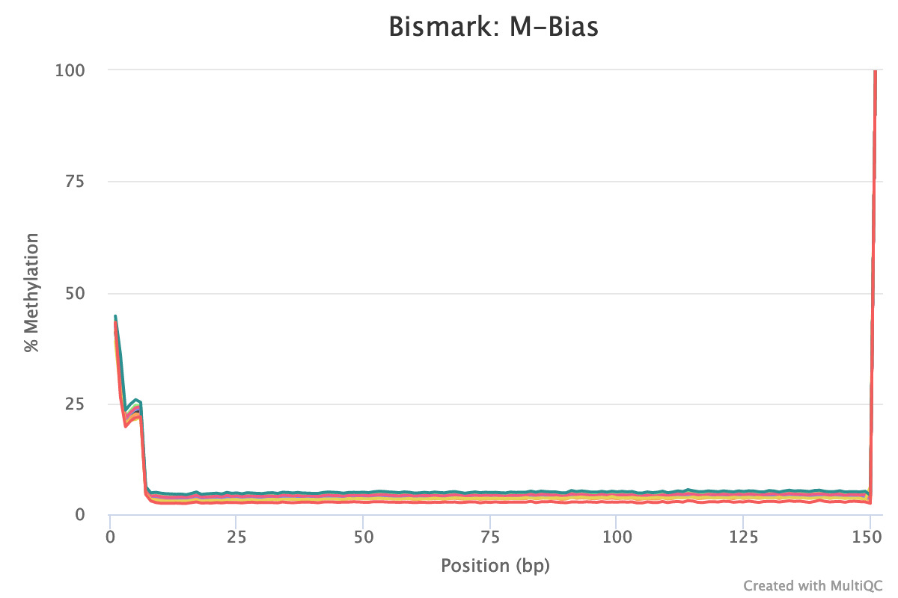
M-Bias this plot shows the average percentage methylation and coverage across reads

Slide 36
Conclusion
Raw data analysis and general visualization
High quality data
Similar general trends in our data, such as mapping efficiency, methylation ratio, and methylation context ….

Slide 37
Future plans
Improvement in mapping efficiency
Drawing one or two meaningful conclusions for one figure (publications)
What questions we want to figure out … eg. methylation in different positions
Combining questions and our data
Other visualization methods

Slide 38
What I have learned…
Similar raw data process and and distinct data visualization methods
(quality control, remove adapters, alignment, remove PCR duplication…)
Batch data processing and improving working efficiency
packages(multiqc), and options (multicores), a new programming language
Problem Solving
Forums, videos, papers, developer …..

Slide 39

THANK YOU
Robin, Lei, Ryan
Felix Krueger
Jie Zhang
SHUYA

Slide 40
Supplementary
Materials
SHUYA
Notes:
1. `Quality control before trimming:
/home/u1574607/miniconda3/bin/fastqc cabsau_R1.fastq -o /mnt/data/shuya/WGBS_modern/1_quality_control/
2. Remove adapters and trim low-quality basepair
/usr/bin/trim_galore --length 75 --paired cabsau_R1.fastq cabsau_R2.fastq -o /mnt/data/shuya/WGBS_modern/2_cutadapt/
remove adapters
trim basepairs which quality score is under 25
remove read which length is under 75bp
3. Quality control after trimming:
/home/u1574607/miniconda3/bin/fastqc cabsau_R1_val_1.fq cabsau_R2_val_2.fq -o /mnt/data/shuya/WGBS_modern/3_qc_trimed/
4. Alignment
genome preparation
/home/u1995087/miniconda3/bin/Bismark-0.22.3/bismark_genome_preparation /mnt/data/shuya/WGBS_modern/ref/
alignment
/home/u1995087/miniconda3/bin/Bismark-0.22.3/bismark /mnt/data/shuya/WGBS_modern/ref/ -1 cabsau_R1_val_1.fq -2 cabsau_R2_val_2.fq -o /mnt/data/shuya/WGBS_modern/4_aln/
5. Remove PCR duplication
/home/u1995087/miniconda3/envs/wgbs_tools/bin/deduplicate_bismark --bam cabsau_R1_val_1_bismark_bt2_pe.bam
6. Methylation calling
/home/u1995087/miniconda3/envs/wgbs_tools/bin/bismark_methylation_extractor --multicore 8 -p --no_overlap --report --cytosine_report --bedGraph --genome_folder /mnt/data/shuya/WGBS_modern/ref/ chasselas_R1_val_1_bismark_bt2_pe.deduplicated.bam gamay_R1_val_1_bismark_bt2_pe.deduplicated.ba -o /mnt/data/shuya/WGBS_modern/5_methylation_calling/
7. Summary
individual summary
/home/u1995087/miniconda3/envs/wgbs_tools/bin/bismark2report --dir /mnt/data/shuya/WGBS_modern/6_summary_report/ --dedup_report cabsau_R1_val_1_bismark_bt2_pe.deduplication_report.txt
overview
/home/u1995087/miniconda3/envs/wgbs_tools/bin/bismark2summary chardonnay_R1_val_1_bismark_bt2_pe.deduplicated.bam chasselas_R1_val_1_bismark_bt2_pe.deduplicated.bam gamay_R1_val_1_bismark_bt2_pe.deduplicated.bam muscat.e_R1_val_1_bismark_bt2_pe.deduplicated.bam muscat.a_R1_val_1_bismark_bt2_pe.deduplicated.bam pinot.n.aus_R1_val_1_bismark_bt2_pe.deduplicated.bam pinot.n_R1_val_1_bismark_bt2_pe.deduplicated.bam riparia_R1_val_1_bismark_bt2_pe.deduplicated.bam

Slide 41
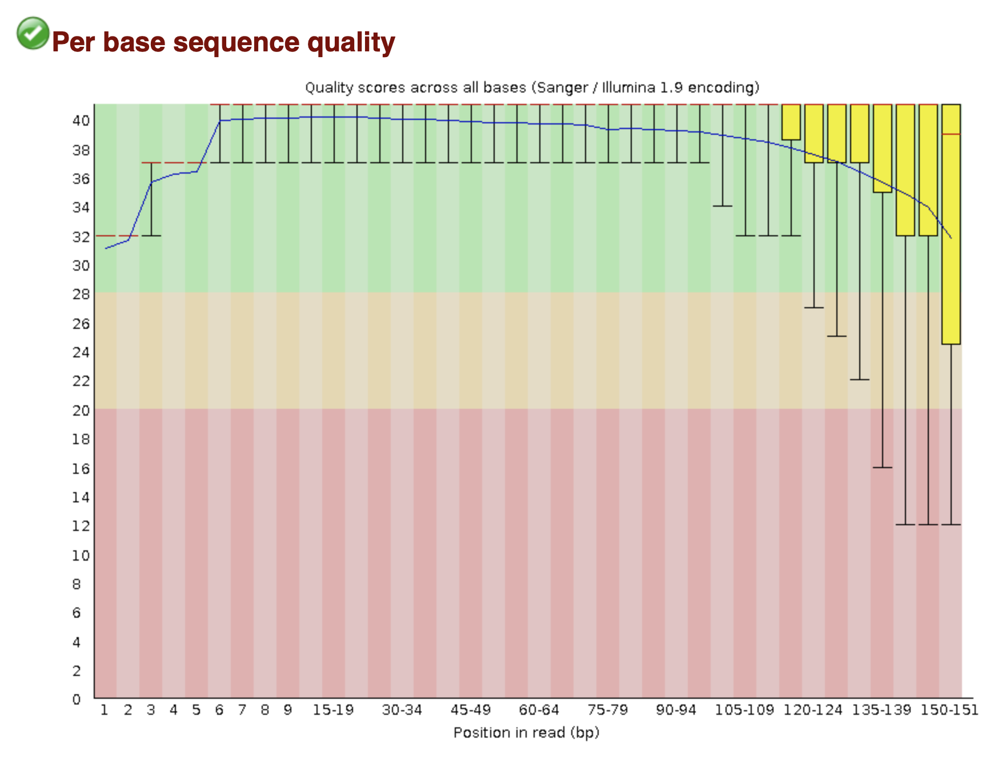
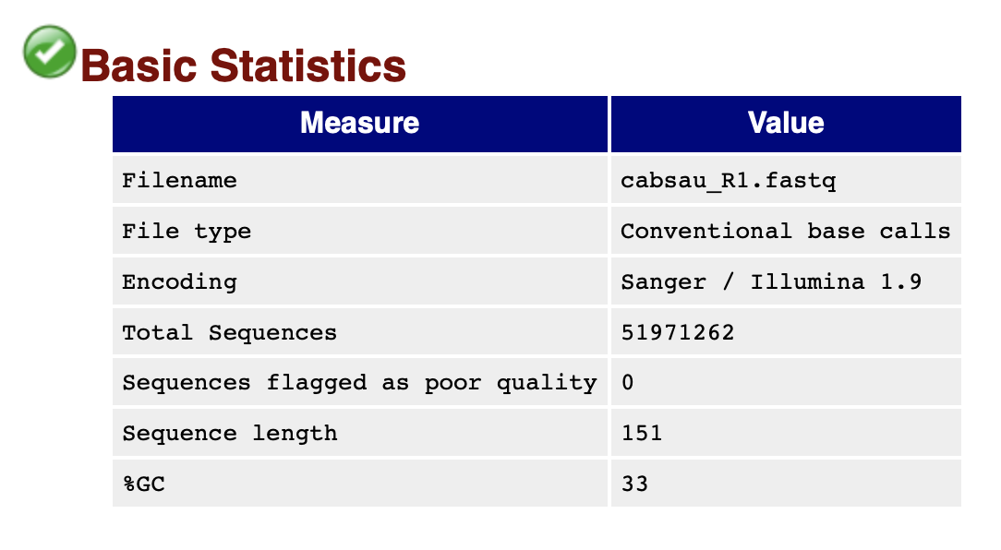
Cabsau R1
Notes:
Fastqc link file:///private/var/folders/ky/cgbswyn96rldcyrgjb1srqh0bsjxg7/T/fz3temp-2/cabsau_R1_fastqc.html/
Fastqc version FastQC v0.11.4
Trim Galore是对FastQC和Cutadapt的包装。适用于所有高通量测序，包括RRBS(Reduced Representation Bisulfite-Seq ), Illumina、Nextera 和smallRNA测序平台的双端和单端数据。主要功能包括两步： 第一步首先去除低质量碱基，然后去除3' 末端的adapter, 如果没有指定具体的adapter，程序会自动检测前1million的序列，然后对比前12-13bp的序列是否符合以下类型的adapter:
Illumina: AGATCGGAAGAGC
Small RNA: TGGAATTCTCGG
Nextera: CTGTCTCTTATA
Now performing quality (cutoff 20) and adapter trimming in a single pass for the adapter sequence: 'AGATCGGAAGAGC'

Slide 42






Notes:
/bin/bismark /mnt/data/shuya/reference_genome/Bisulfite_Genome/

Slide 43
Suppose to be like …
Jhg gh

Slide 44


Cabsau R2
Notes:
Fastqc link file:///private/var/folders/ky/cgbswyn96rldcyrgjb1srqh0bsjxg7/T/fz3temp-2/cabsau_R2_fastqc.html/
Fastqc version

Slide 45






Notes:
Fastqc link file:///private/var/folders/ky/cgbswyn96rldcyrgjb1srqh0bsjxg7/T/fz3temp-2/cabsau_R2_fastqc.html/

Slide 46


Cabsau R1
Jhg gh

Slide 47


Bismark Alignment Stats Summary

